Slide 1

Presentation M5 - ScholarLog
04
Demonstration
01
Problematics
02
Needs
05
Conclusion
26.06.11 - Hofer Lukas - TINF2
03
My solution
06
Questions
Duration of presentation: 15 min (5 min questions)
Notes:
Date : format international standard ISO 8601

Slide 2
Content
01
Problematics
01
Problematics
04
Demonstration
Average rating
Results
Work logs
02
Needs
05
Conclusion
03
My solution
06
Questions
Duration of presentation: 15 min (5 min questions)

Slide 3

Problematics
Content
01
Solutions ? (Excel)
x
01
Problematics
04
Demonstration
Average rating
Results
Work logs
What is my current average ?
Where did I put my proof ?
Where should I keep my work journal ?
02
Needs
05
Conclusion
How do I calculate my average ?
Where should I record my results ?
How much time did I spend on that task ?
03
My solution
06
Questions
Did I calculate correctly ?
Duration of presentation: 15 min (5 min questions)

Slide 4
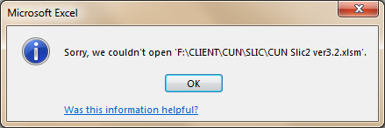
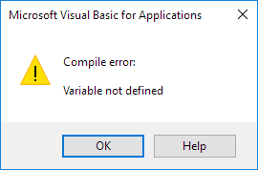
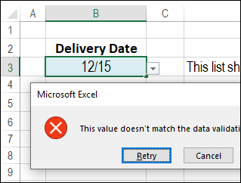
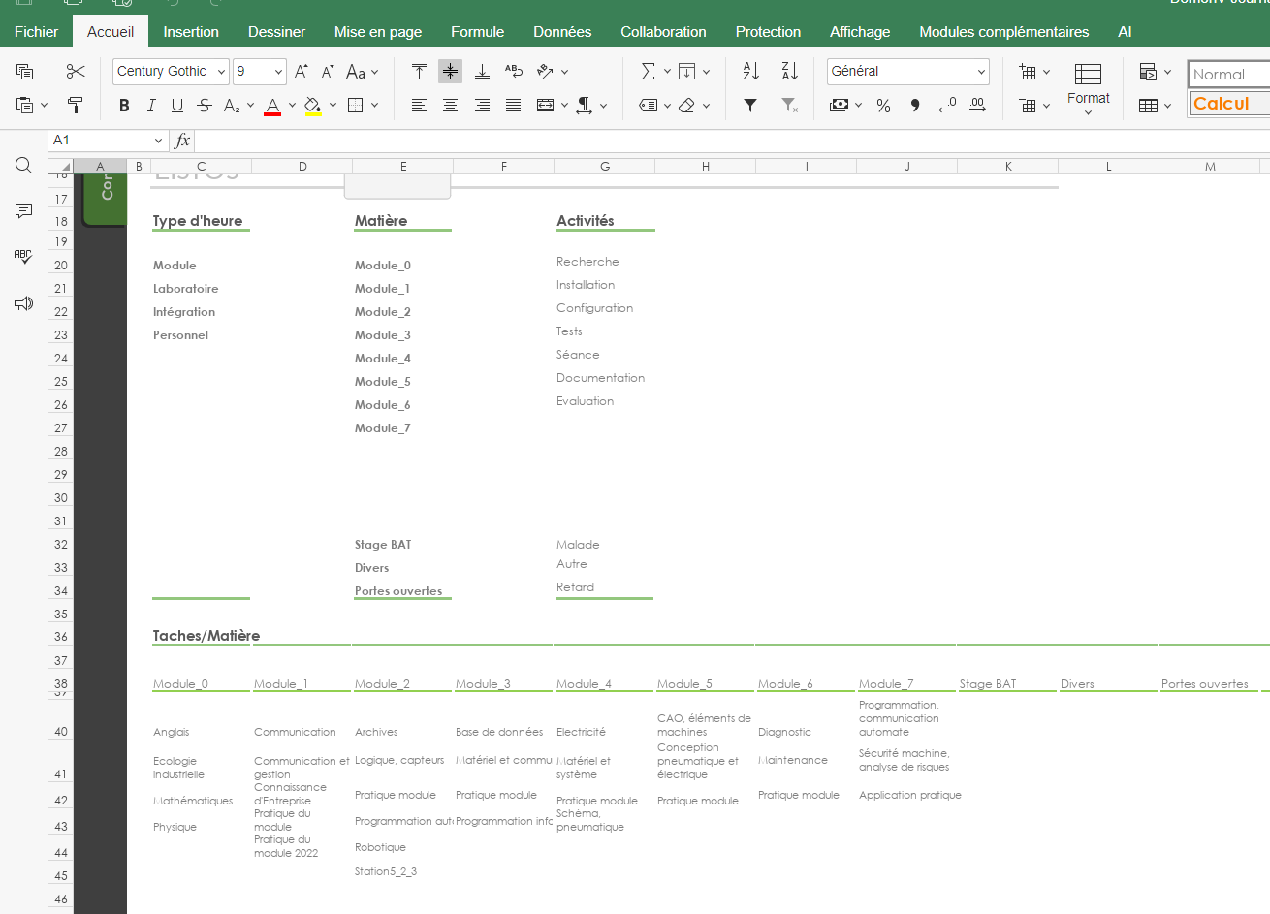
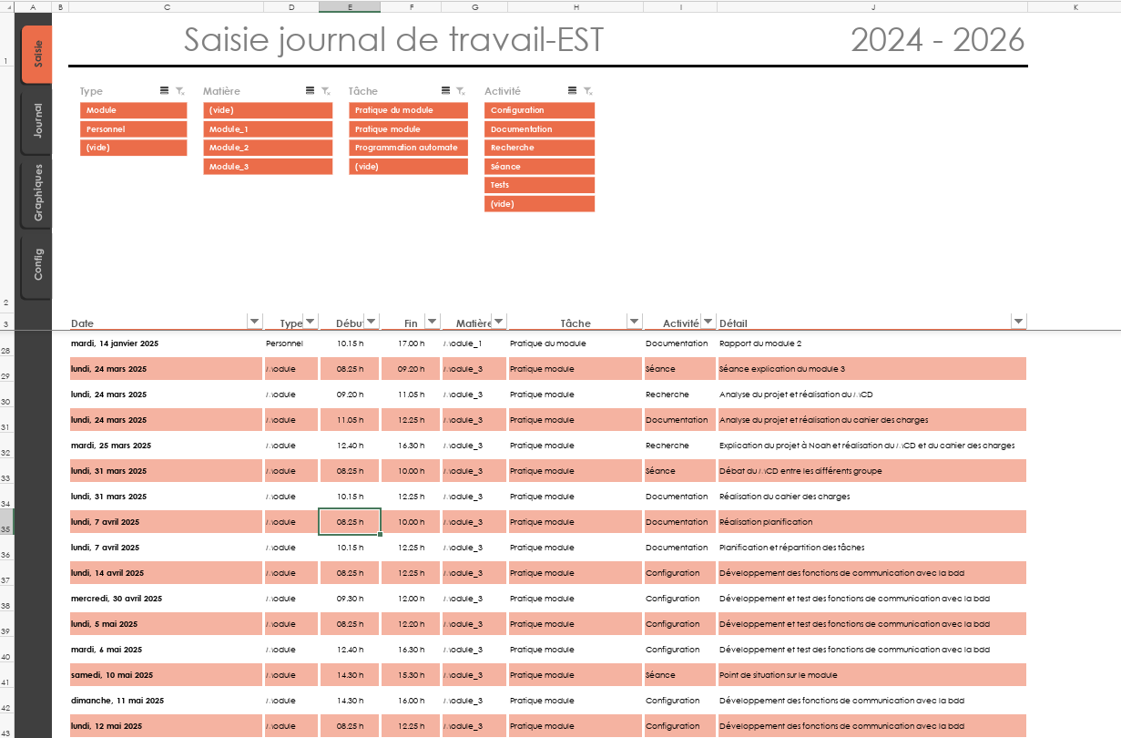
Problematics
01
Solutions ? (Cloud app)
Solutions ? (Excel)
Average rating
Results
Work logs
Technical instability :
Too much macros
What is my current average ?
Where did I put my proof ?
Where should I keep my work journal ?
Heavy ergonomics :
UI is not user friendly
How do I calculate my average ?
Where should I record my results ?
How much time did I spend on that task ?
Did I calculate correctly ?
Archiving not possible :
Not possible to put PDF

Slide 5



Problematics
02
Needs
01
Solutions ? (Excel)
What a student really need ?
Solutions ? (Cloud app)
Confidentiality :
You don’t really own your own data
Technical instability :
Too much macros
Heavy ergonomics :
UI is not user friendly
Internet only :
No access to your results or scans when offline
Archiving not possible :
Not possible to put PDF
time consuming :
You build your own databases from scratch

Slide 6
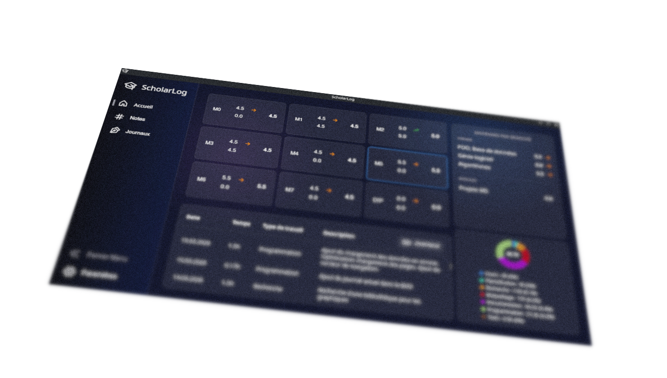
Needs
01
Problematics
Solutions ? (Cloud app)
03
My solution
02
The ScholarLog Application
What a student really need ?
Confidentiality :
You don’t really own your own data
A Tailor-Made Tool
ScholarLog is an offline, all-in-one desktop application built
specifically for EST students.
Automatic Math
Instant, error-free weighted averages. Stop wasting time calculating grades manually.
All-in-One Hub
Grades, PDF scans, and work journals unified in a single, perfectly organized place.
PDF Support
Link optimized PDF scans directly to the grades and study anywhere without heavy binders.
100% Privacy
Zero cloud dependency.
Your academic data stays completely safe on your local machine.
Internet only :
No access to your results or scans when offline
time consuming :
You build your own databases from scratch

Slide 7
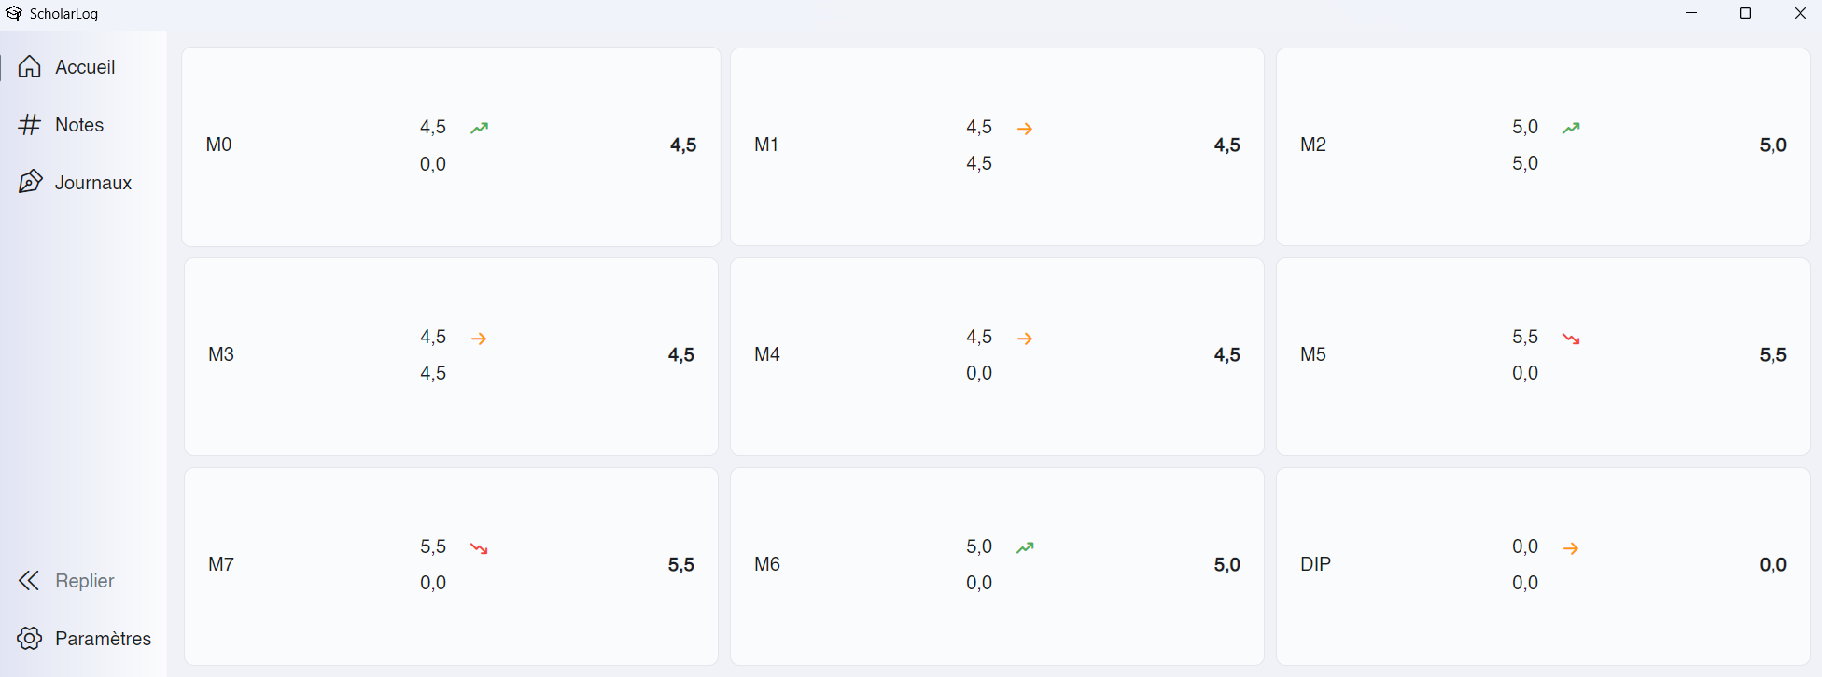
My solution
02
Needs
What a student really need ?
04
Demonstration
03
The ScholarLog Application
A Tailor-Made Tool
ScholarLog is an offline, all-in-one desktop application built
specifically for EST students.
Automatic Math
Instant, error-free weighted averages. Stop wasting time calculating grades manually.
All-in-One Hub
Grades, PDF scans, and work journals unified in a single, perfectly organized place.
PDF Support
Link optimized PDF scans directly to the grades and study anywhere without heavy binders.
100% Privacy
Zero cloud dependency.
Your academic data stays completely safe on your local machine.
Link to the installation files : https://github.com/Hoferlukaslh/ScholarLog/releases/tag/v1.0

Slide 8
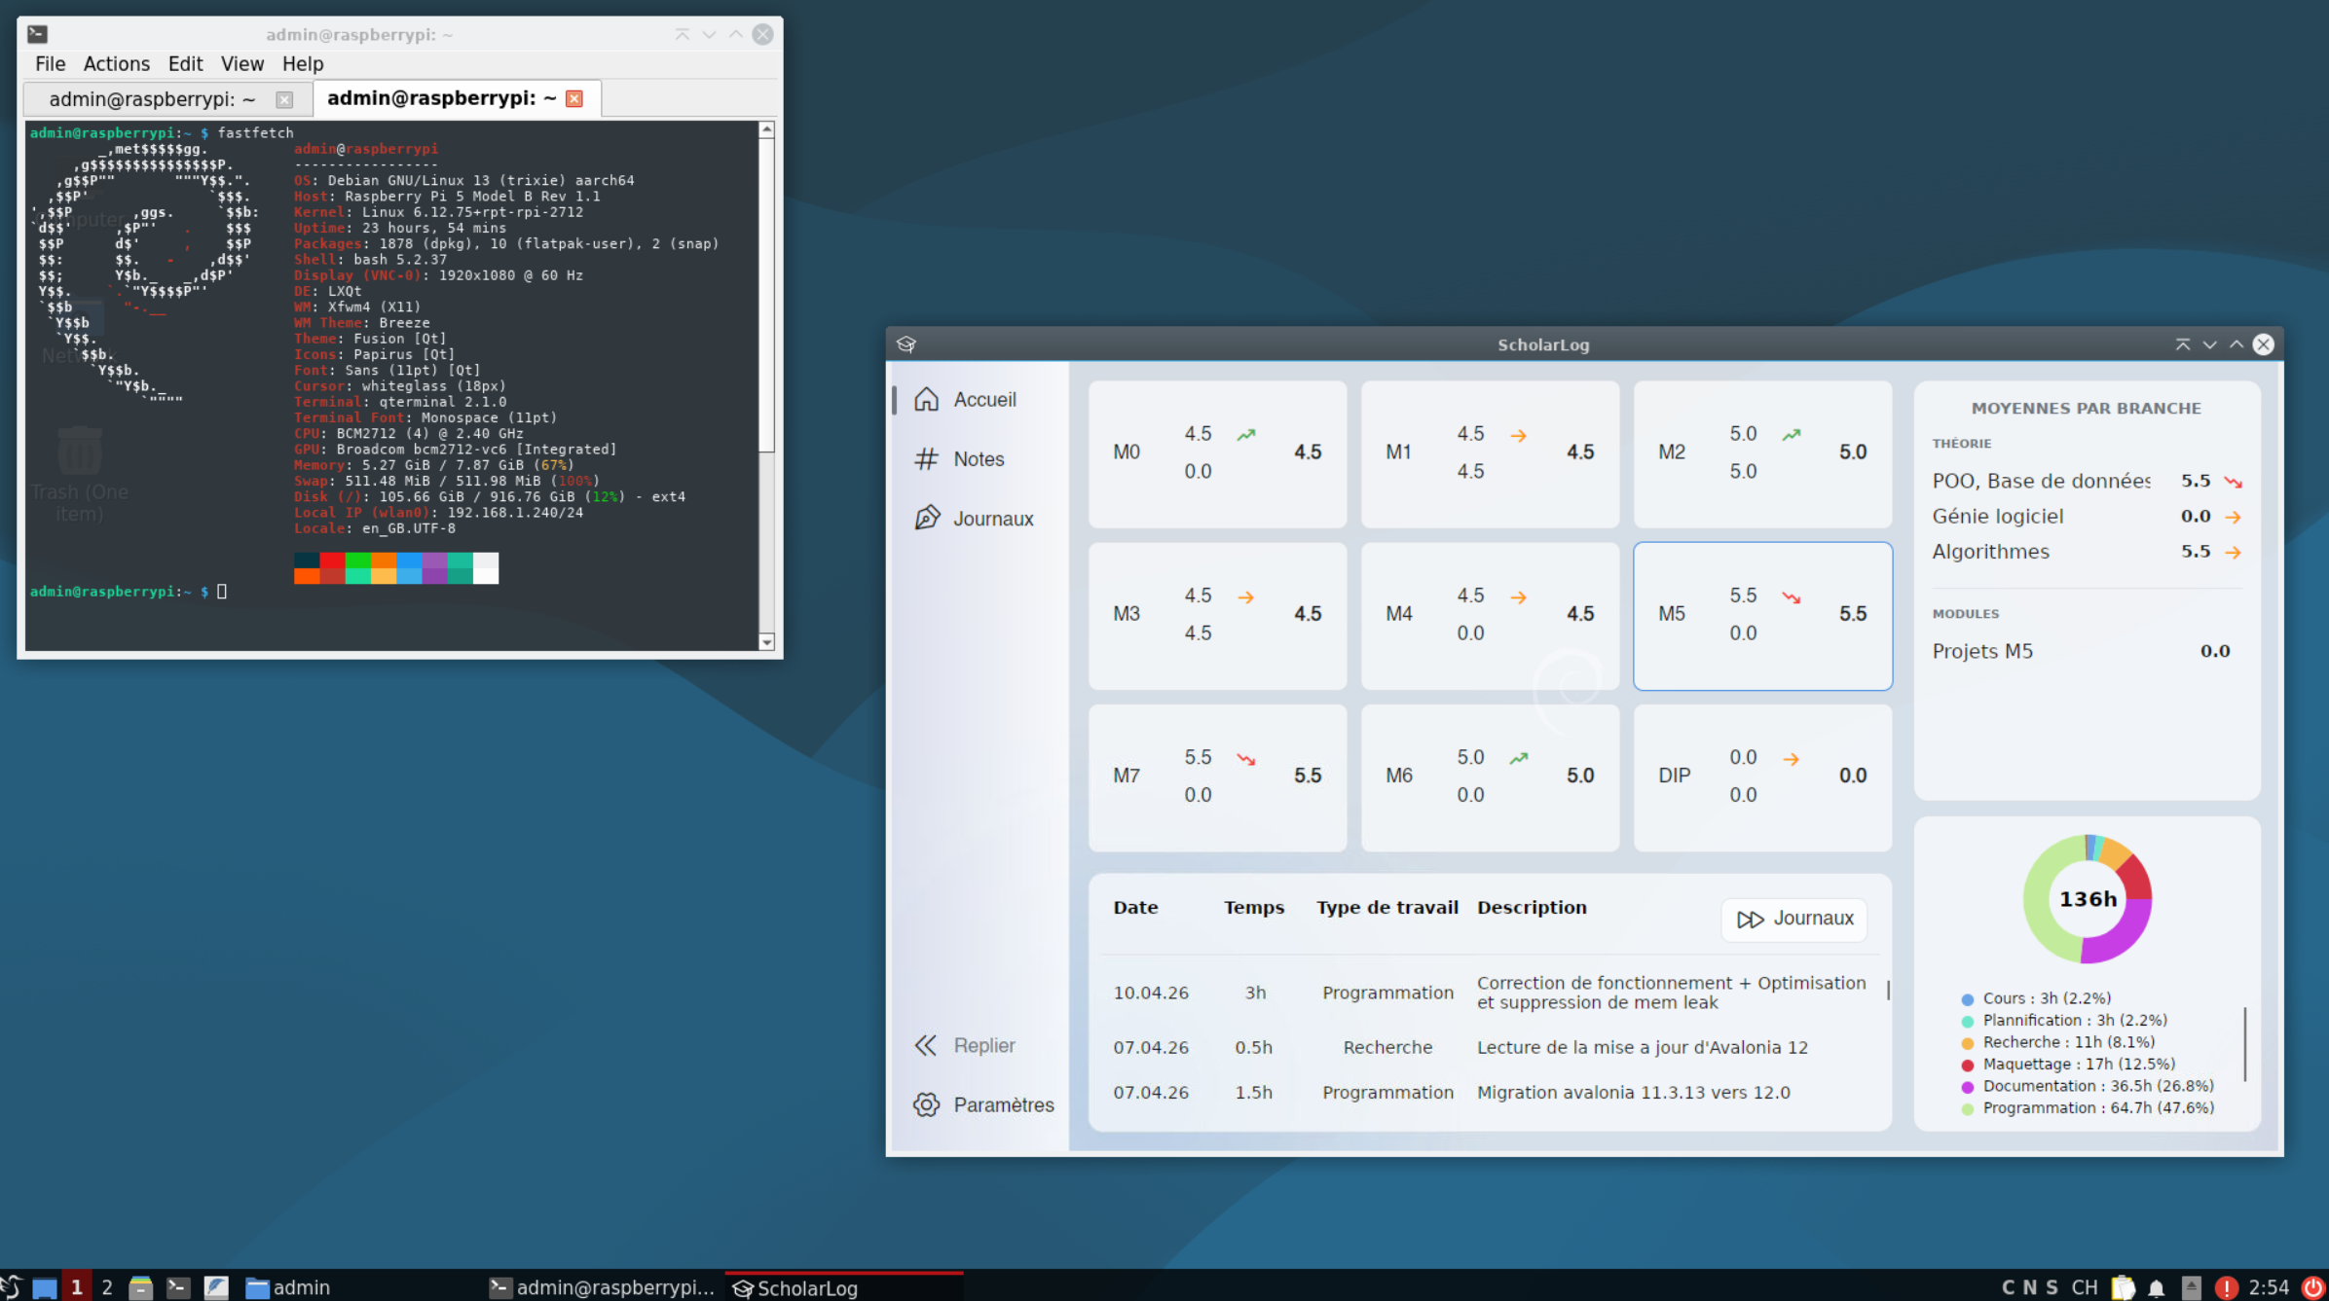
Demonstration
05
Conclusion
Why ScholarLog ?
04
03
My solution
The ScholarLog Application
Time saved
GPLv3 Open Source
Cross-Platform
Link to the installation files : https://github.com/Hoferlukaslh/ScholarLog/releases/tag/v1.0
A Tailor-Made Tool
ScholarLog is an offline, all-in-one desktop application built
specifically for EST students.

Slide 9
Conclusion
07
04
Demonstration
05
Why ScholarLog ?
Time saved
GPLv3 Open Source
Cross-Platform
Eliminates manual calculations and chaotic excel sheets,
saving hours of administrative work every module.
A collaborative, transparent tool.
Free forever, guaranteeing that the code can evolve with future student needs.
Fully automated deployment scripts provide native, optimized installers for Windows, macOS, and Linux.
Link to the installation files : https://github.com/Hoferlukaslh/ScholarLog/releases/tag/v1.0
Questions ?

Slide 10
Questions ?
07
Thanks for your attention !

Slide 11
Thanks for your attention !
Questions ?
07

Slide 12
Thanks for your attention !

